Slide 1
Professional-Self Toolkit App Some WorkFlow Ideas
Dr Rita D’Alton-Harrison
Email Rita.Dalton-Harrison@rhul.ac.uk
Dr Richard Hawley
Email: Richard.Hawley@rhul.ac.uk

Slide 2
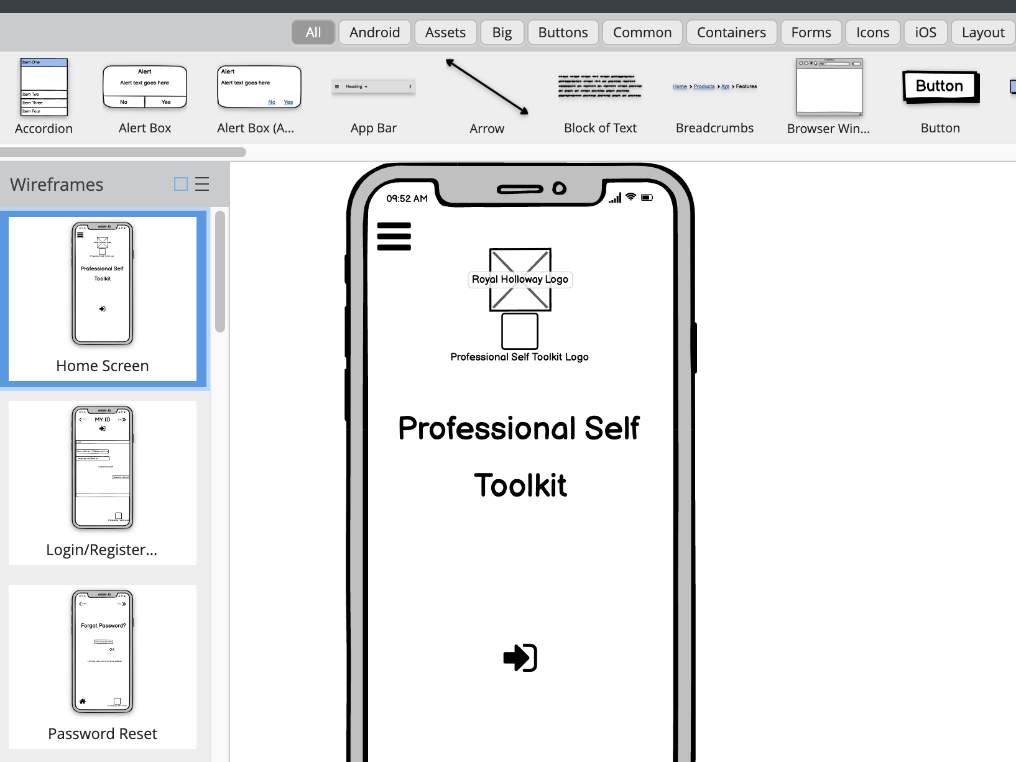
1

Slide 3
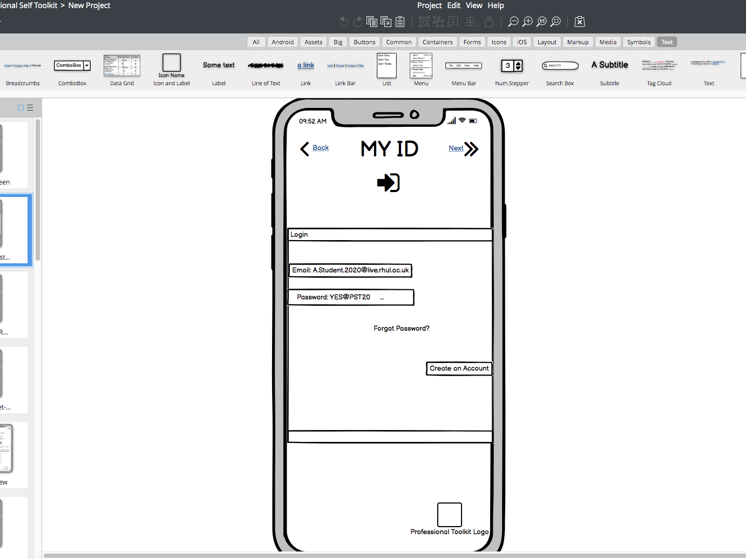
REGISTRATION PAGE
2

Slide 4
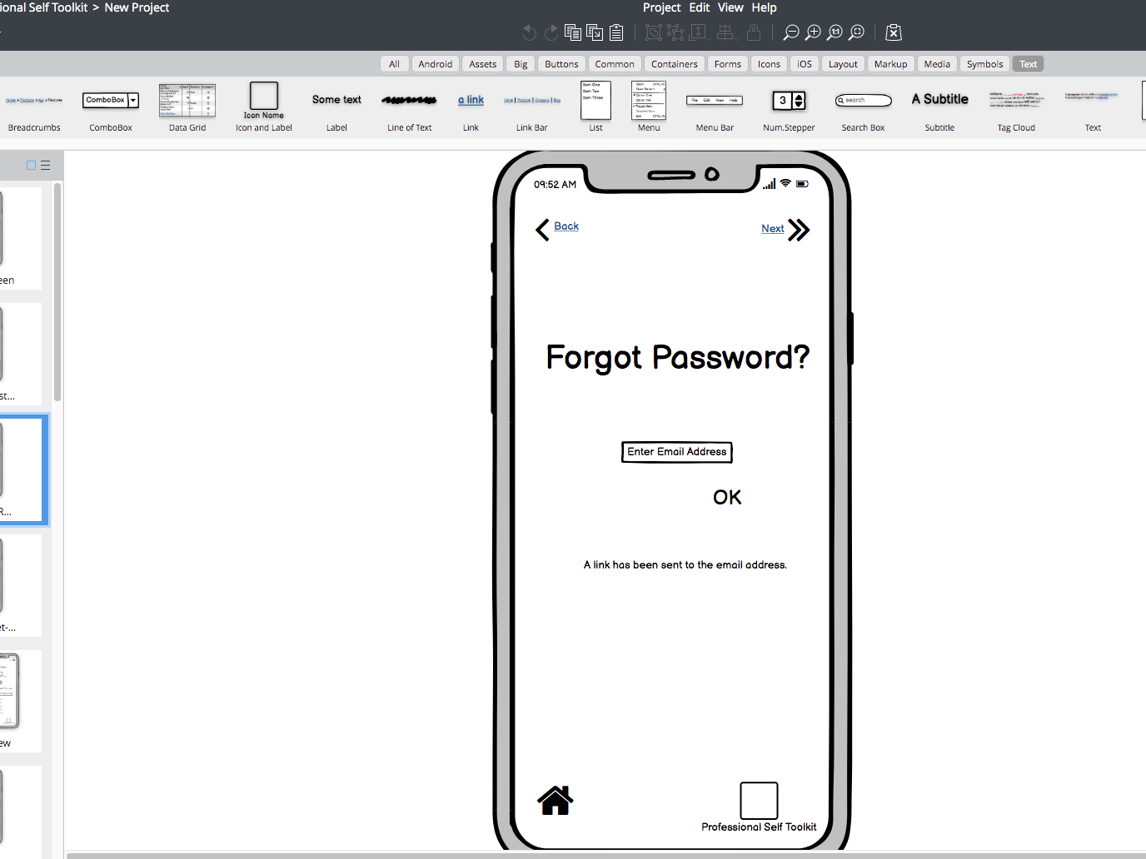
PASSWORD PAGE
3

Slide 5
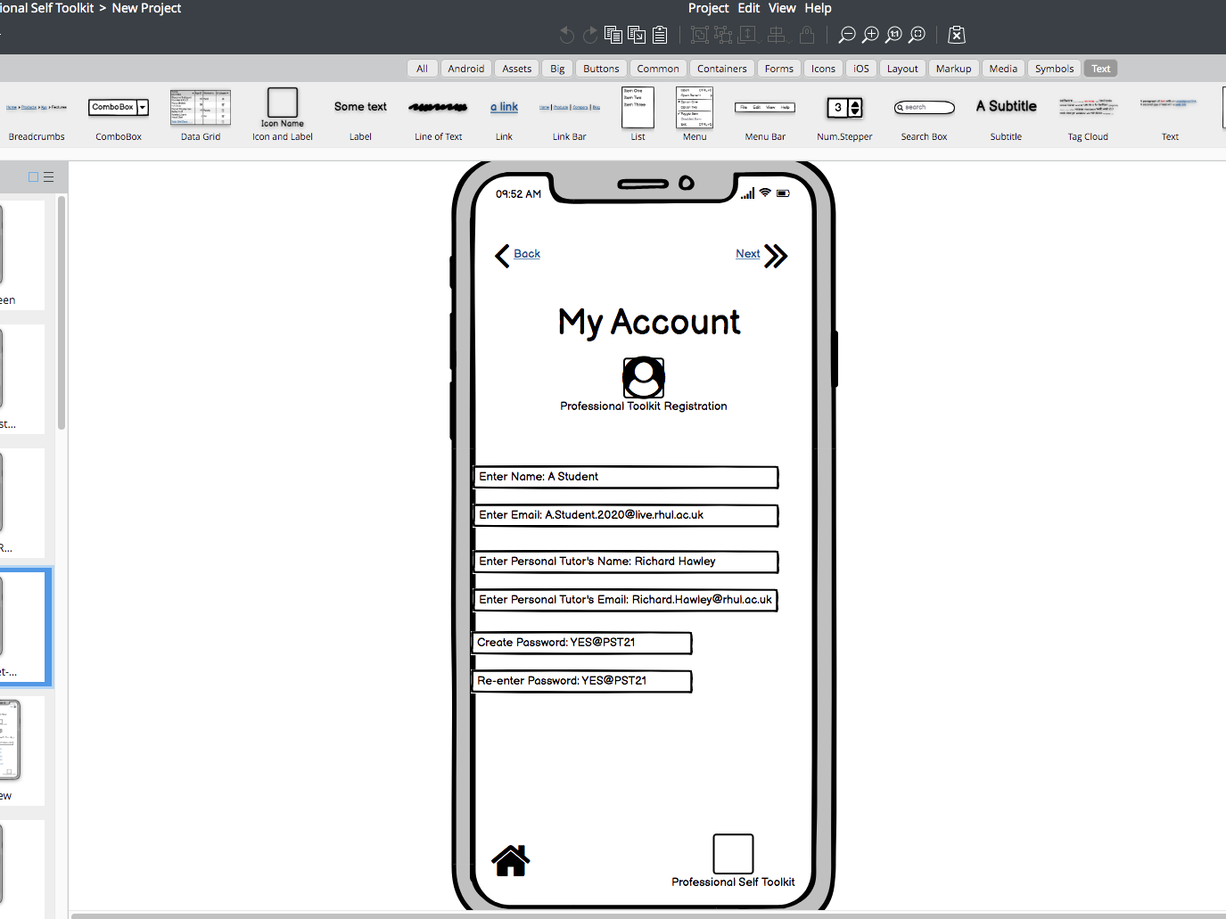
ACCOUNT PAGE
4

Slide 6
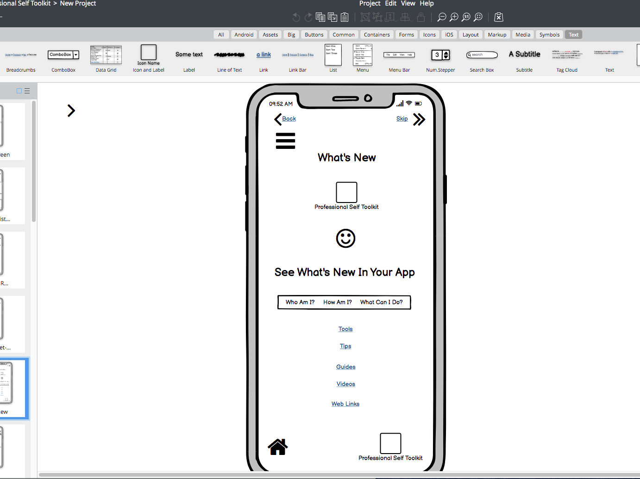
5
NAVIGATION PAGE

Slide 7
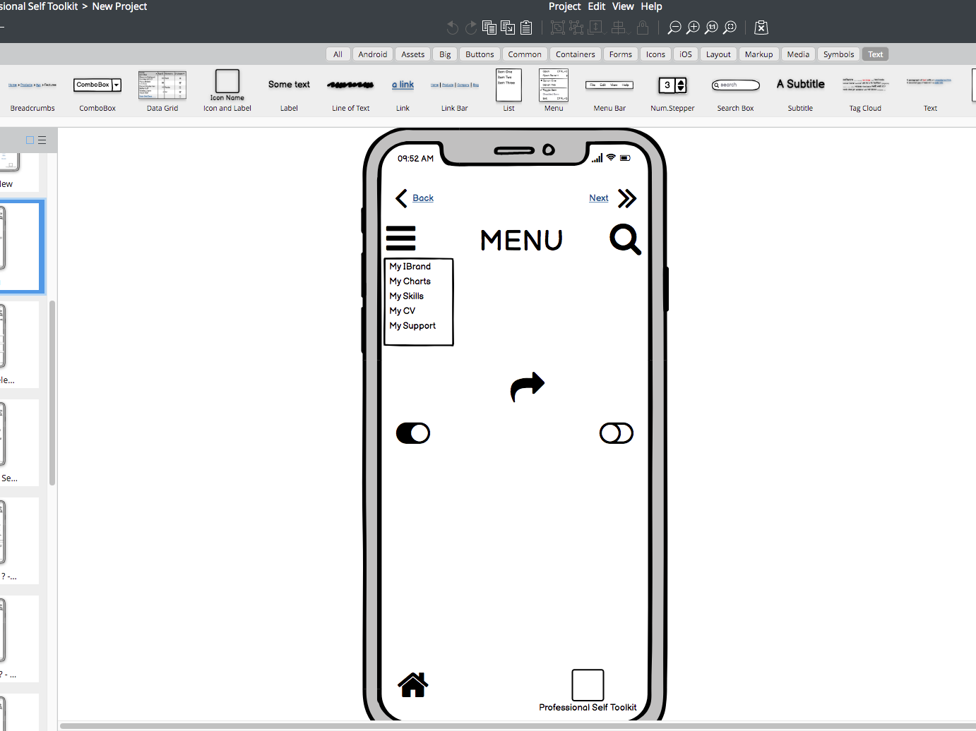
MENU ICON
6

Slide 8
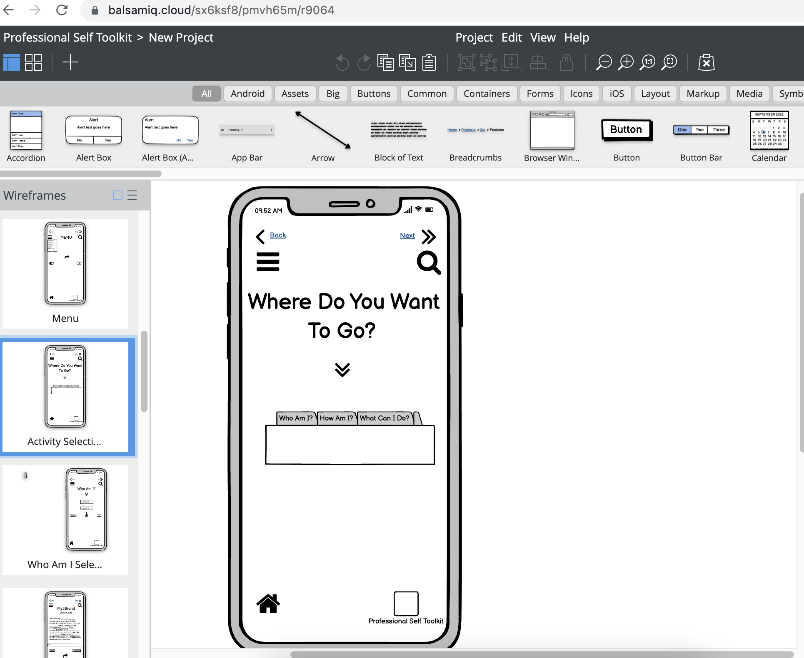
7
ACTIVITY MENU – this can display when student is already logged in with no need to register

Slide 9
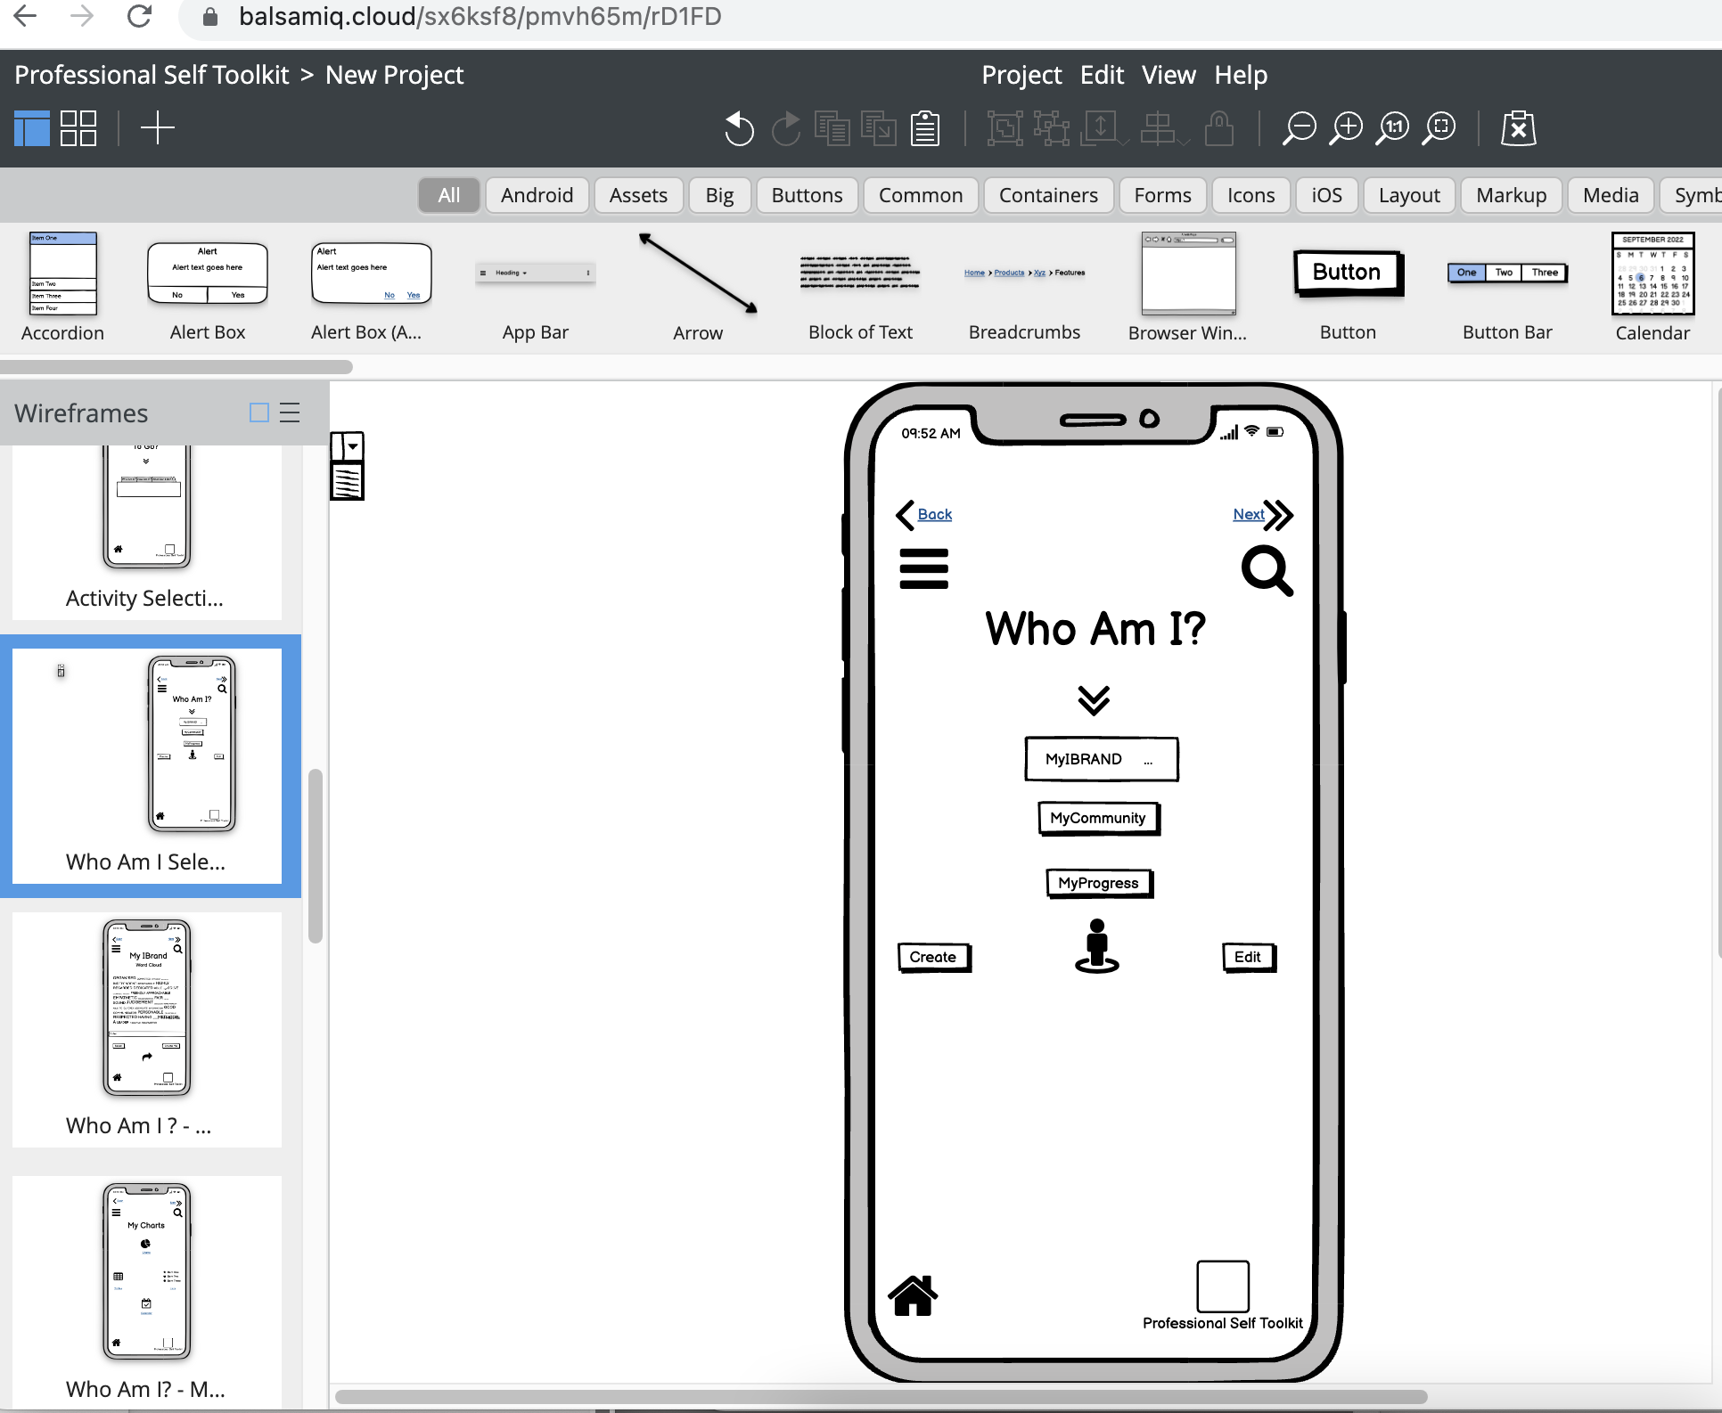
8
NAVIGATION AREA 1,
Page 1 - this is
a landing page when
students
select this area
(see wireframe 7)

Slide 10
ADDITIONAL INSTRUCTIONS
Based on student feedback in the focus groups we created additional features within Navigation Area 1 which are labelled a) ‘MyCommunity’ and b) MyProgress. These would be in addition to the ‘MyIBrand’ feature
MyCommunity - This would be a student-generated area which would include some possible features such as:
1. An interactive map of Surrey/London where students can ‘pin’ certain spots to signpost areas with e.g. best restaurants, cultural events/places, amenities such as hairdressers etc
MyProgress – this would allow students to input grades for assessments with a mathematical formula that will allow them to assess what minimum marks they would need to achieve e.g. 2:1 by end of the year etc

Slide 11
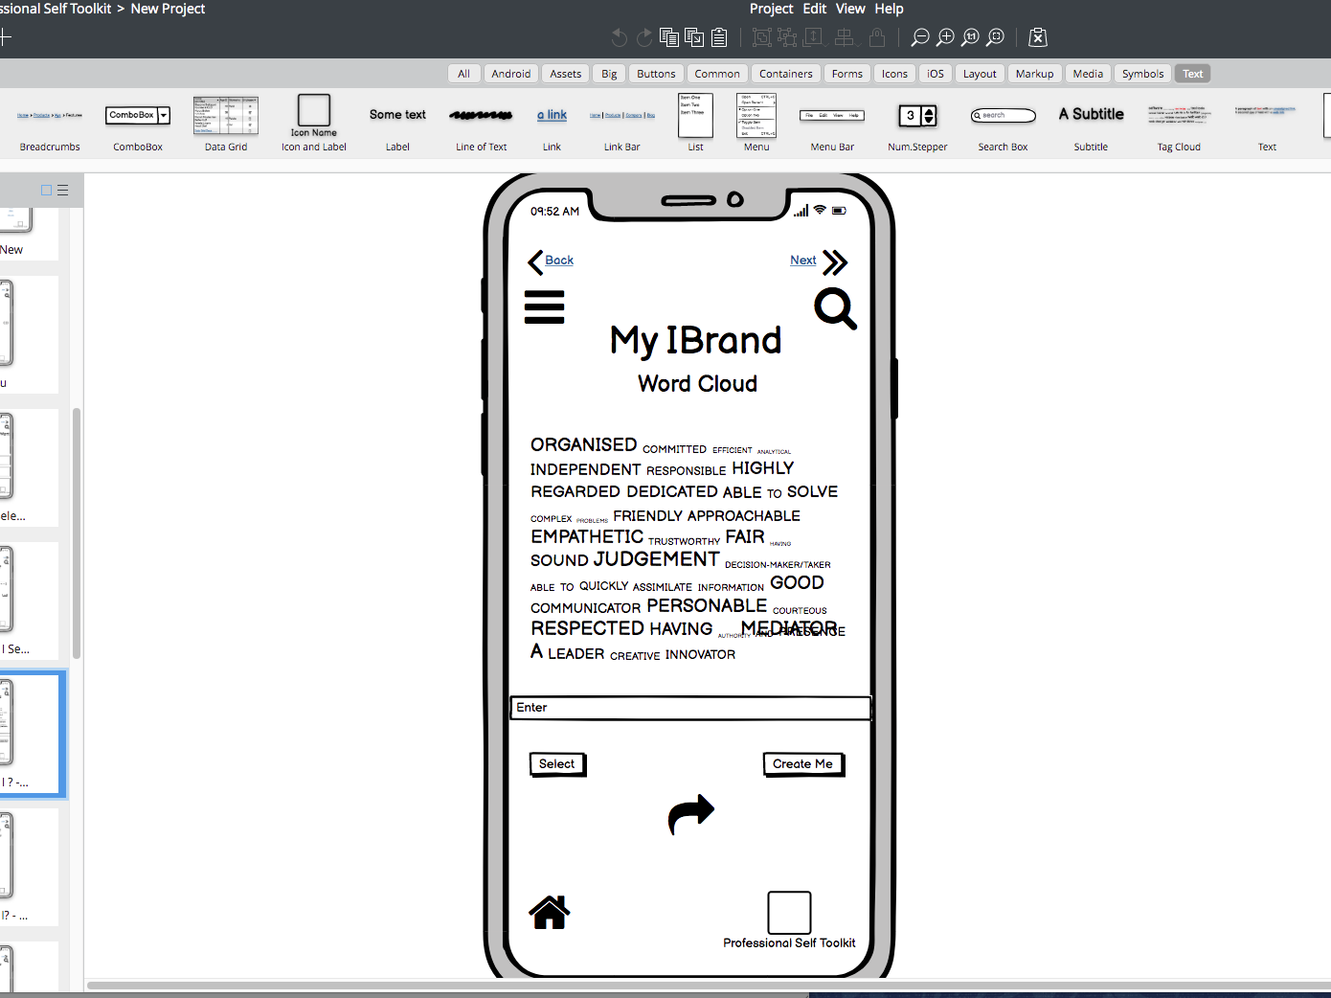
9
NAVIGATION AREA 1 –
Page 2
can use word
employability charts
provided by Rita/Richard
to create gamification
feature for skills)

Slide 12
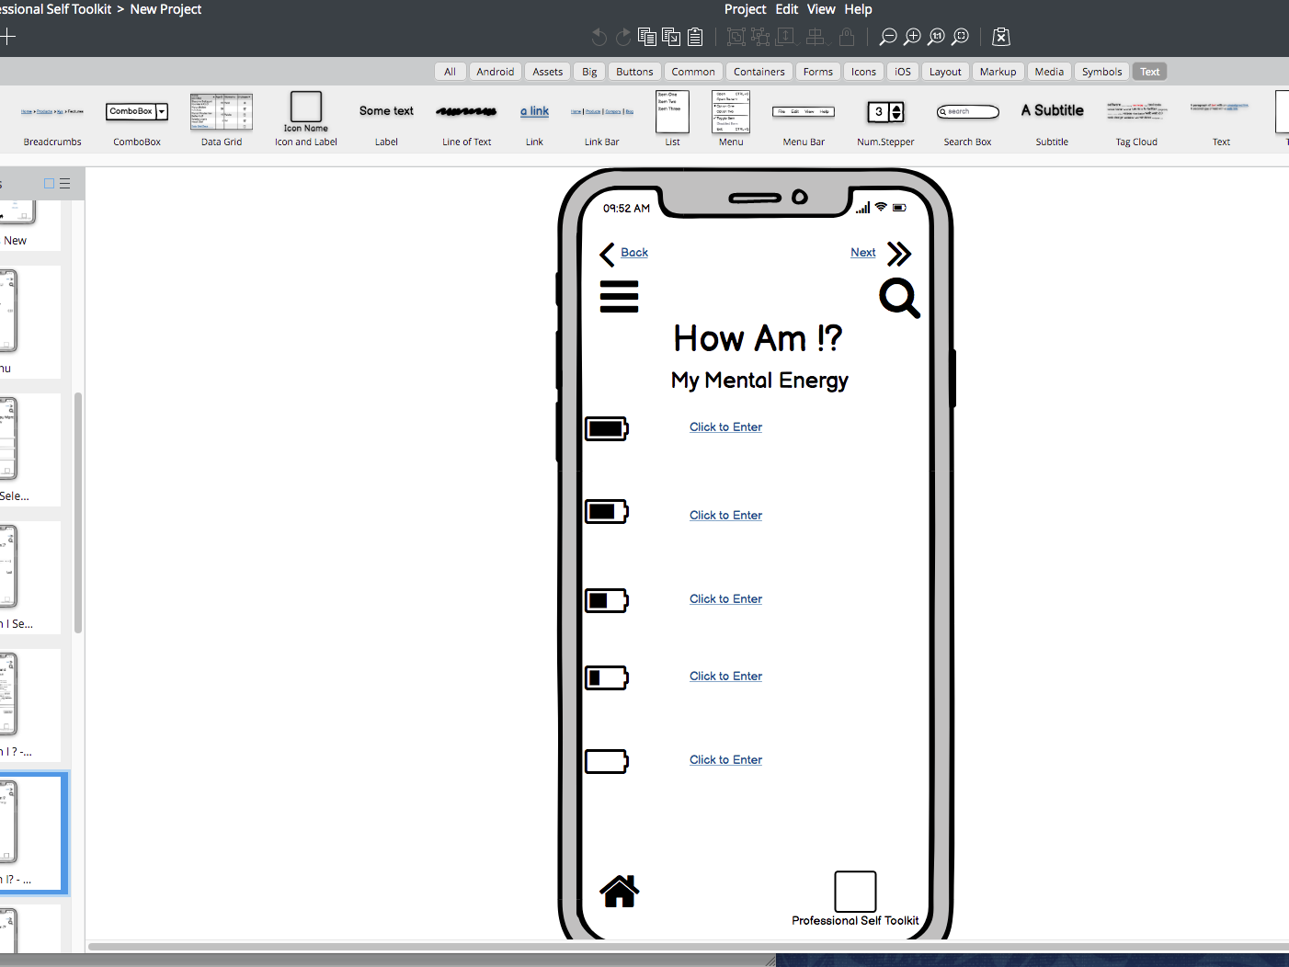
10
NAVIGATION AREA 2, Page 1 –
this is a landing page when
students
select this area
(see wireframe 7)

Slide 13
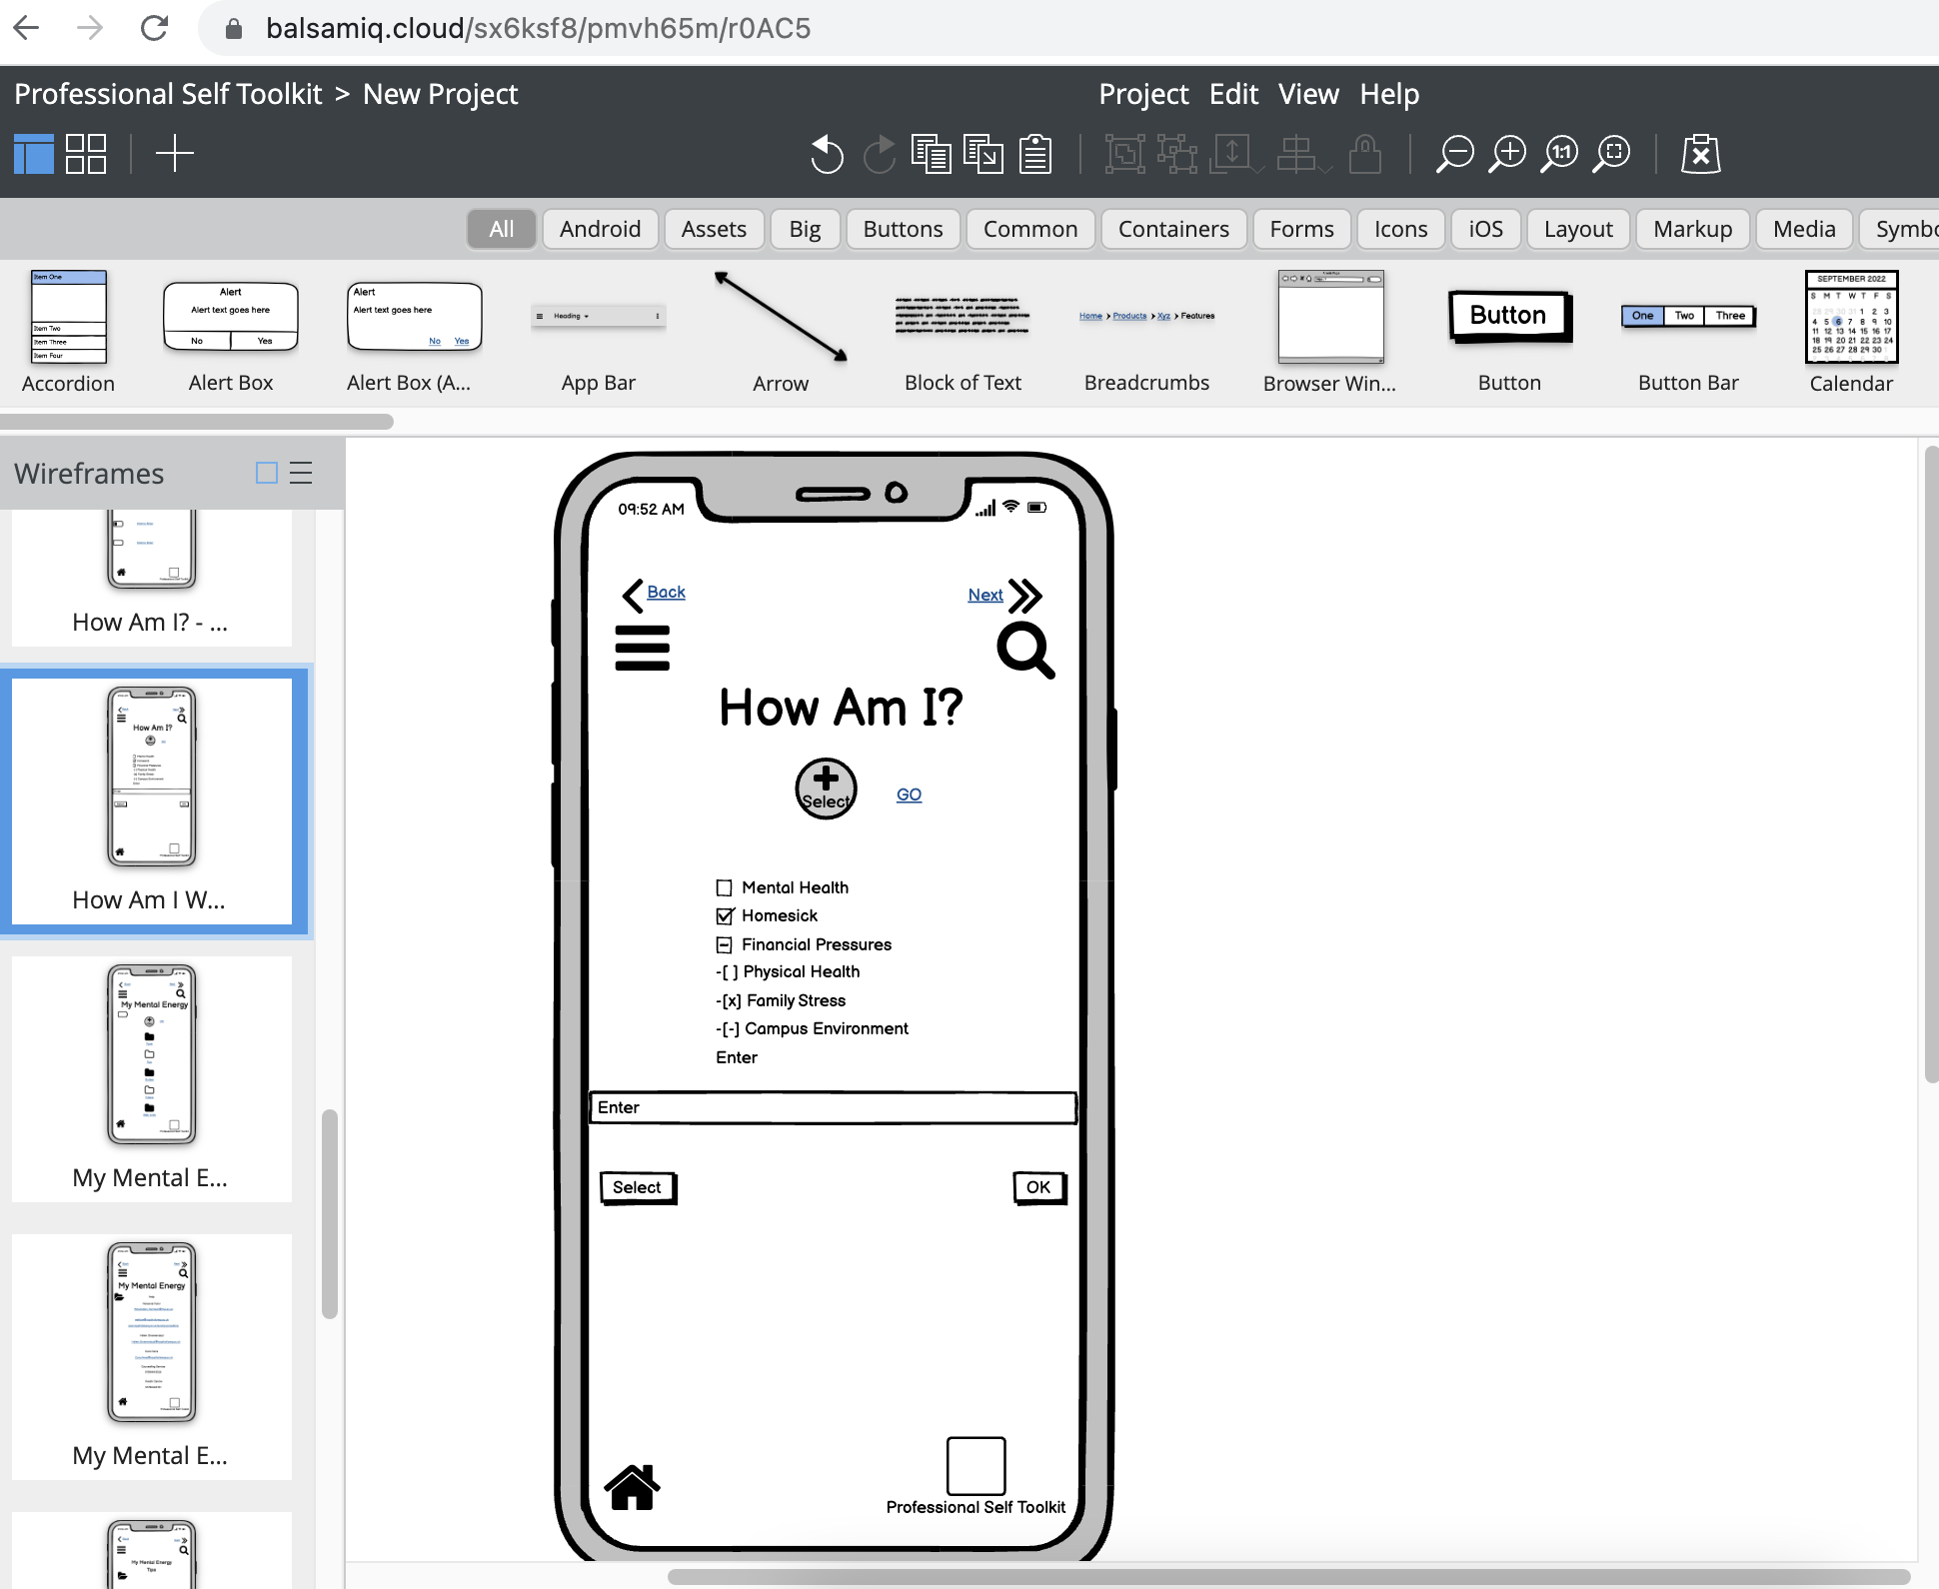
11
NAVIGATION AREA 2 – page 2
This list appears/is connected
to all the battery icons on
page 1. Each part of the list will have
a resource (e.g. mindfulness
video/book/web link connected
to it (see next slide)

Slide 14
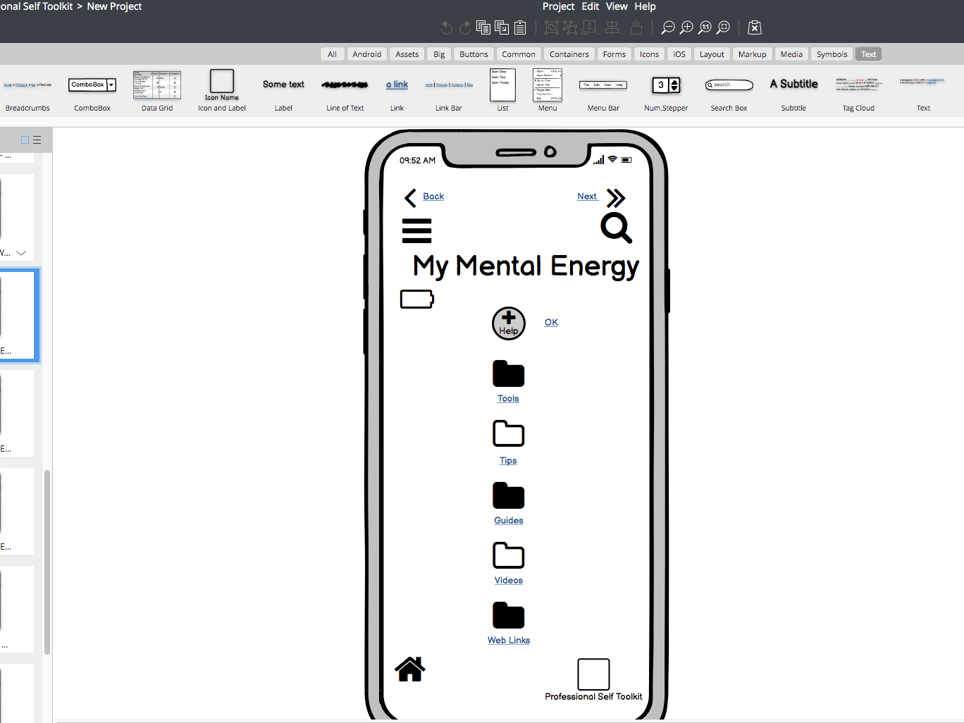
NAVIGATION AREA 2 –
page 3 – icons for resources
connected to list on page 2 –
we envisage the ‘tips’
section including an
Information page with info
on e.g. managing finances,
Legal advice on tenant’s
Rights, Academic writing tips
etc.
We could therefore just start
with populating the ‘tips’
and ‘guides’ sections for
the demo App
12

Slide 15
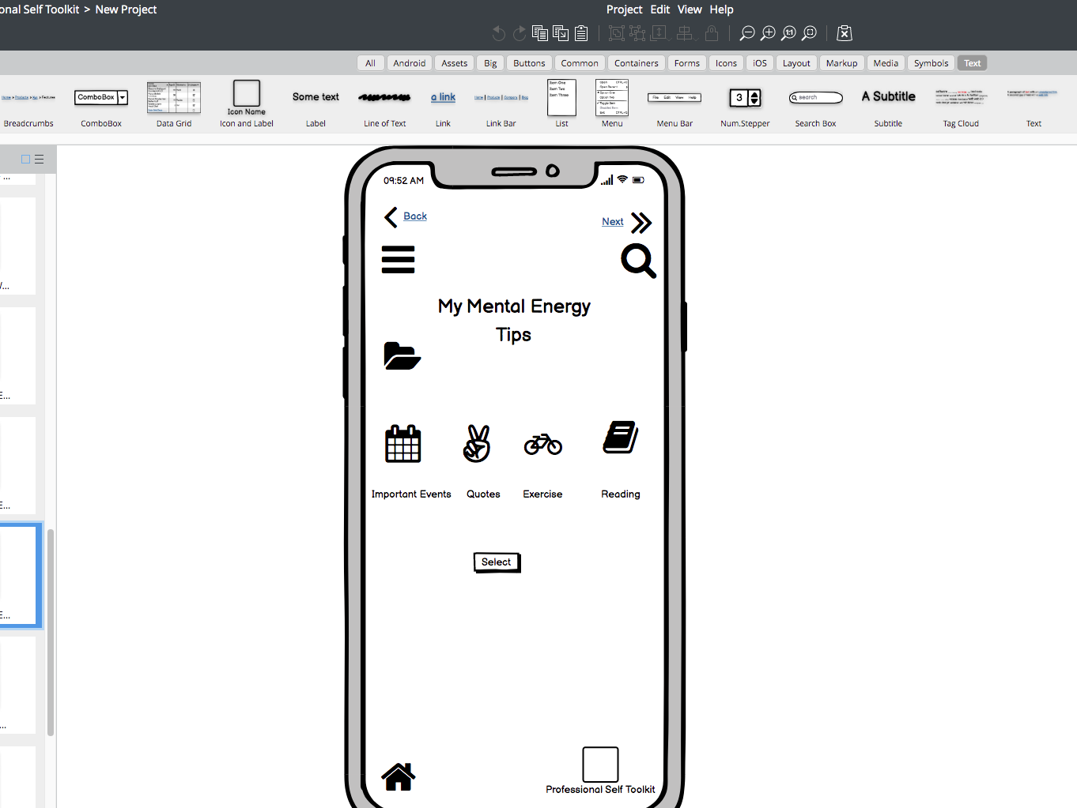
13
NOT NEEDED FOR DEMO

Slide 16
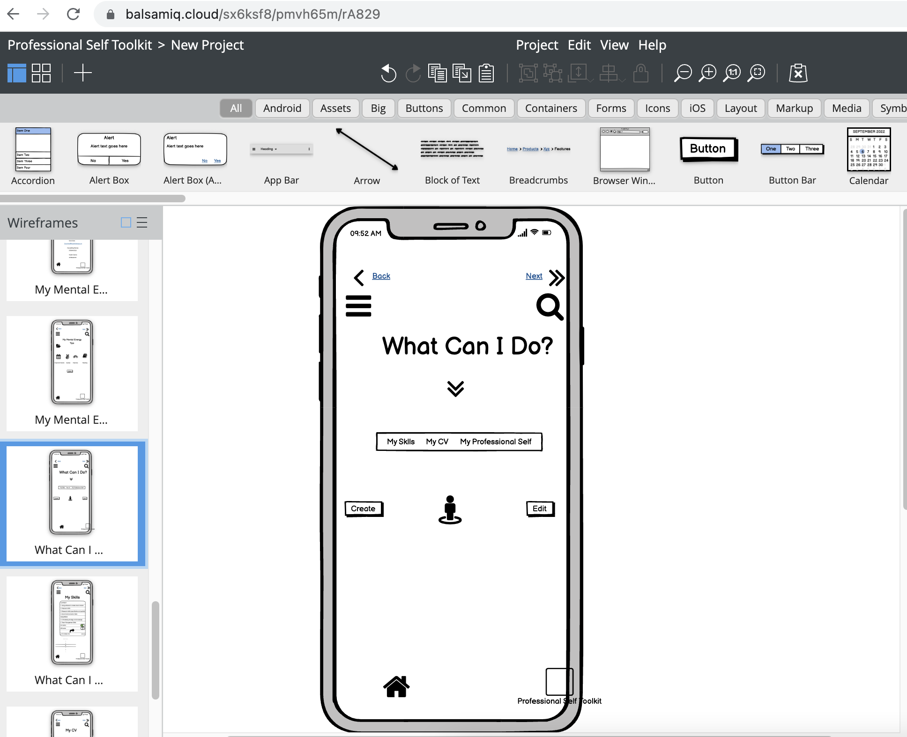
14
NAVIGATION AREA 3 –
Page 1 – this is
a landing page when students
select this area
(see wireframe 7)

Slide 17
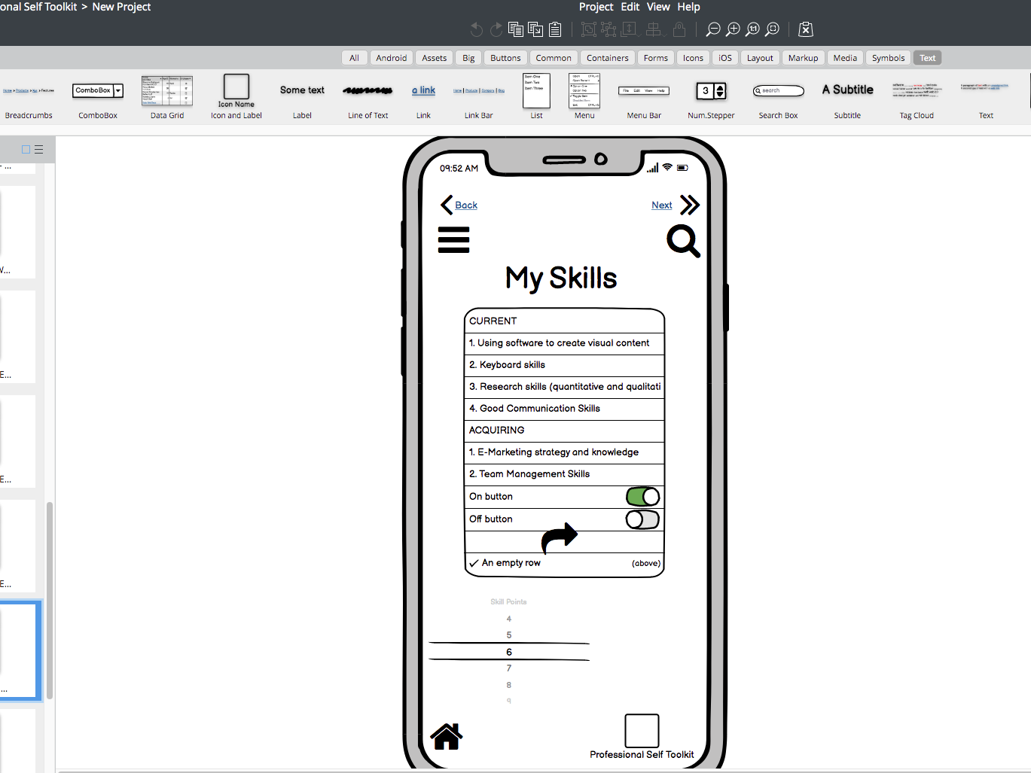
NAVIGATION AREA 3 –
Page 1 – this is a display
page that is connected to
the data students inputted
Earlier (see wireframe 9)
14

Slide 18
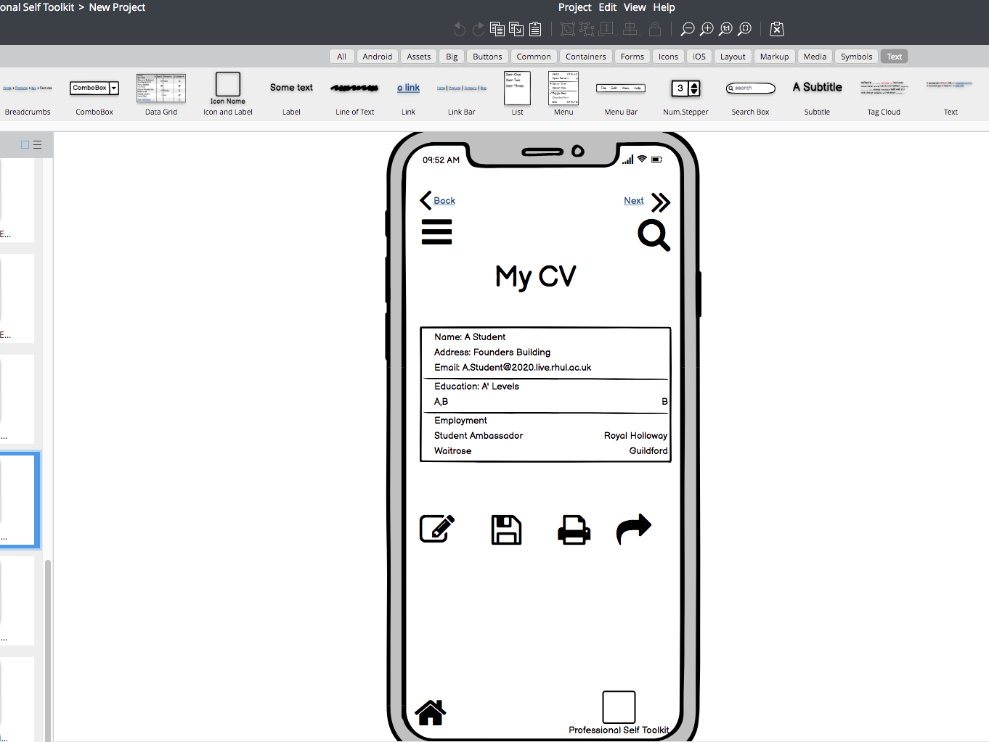
15
NAVIGATION AREA, Page 3 -
This will be word templates of
CVs with pre-determined
headings and students
input data – word docs to
Be provided by Rita/Richard

Slide 19
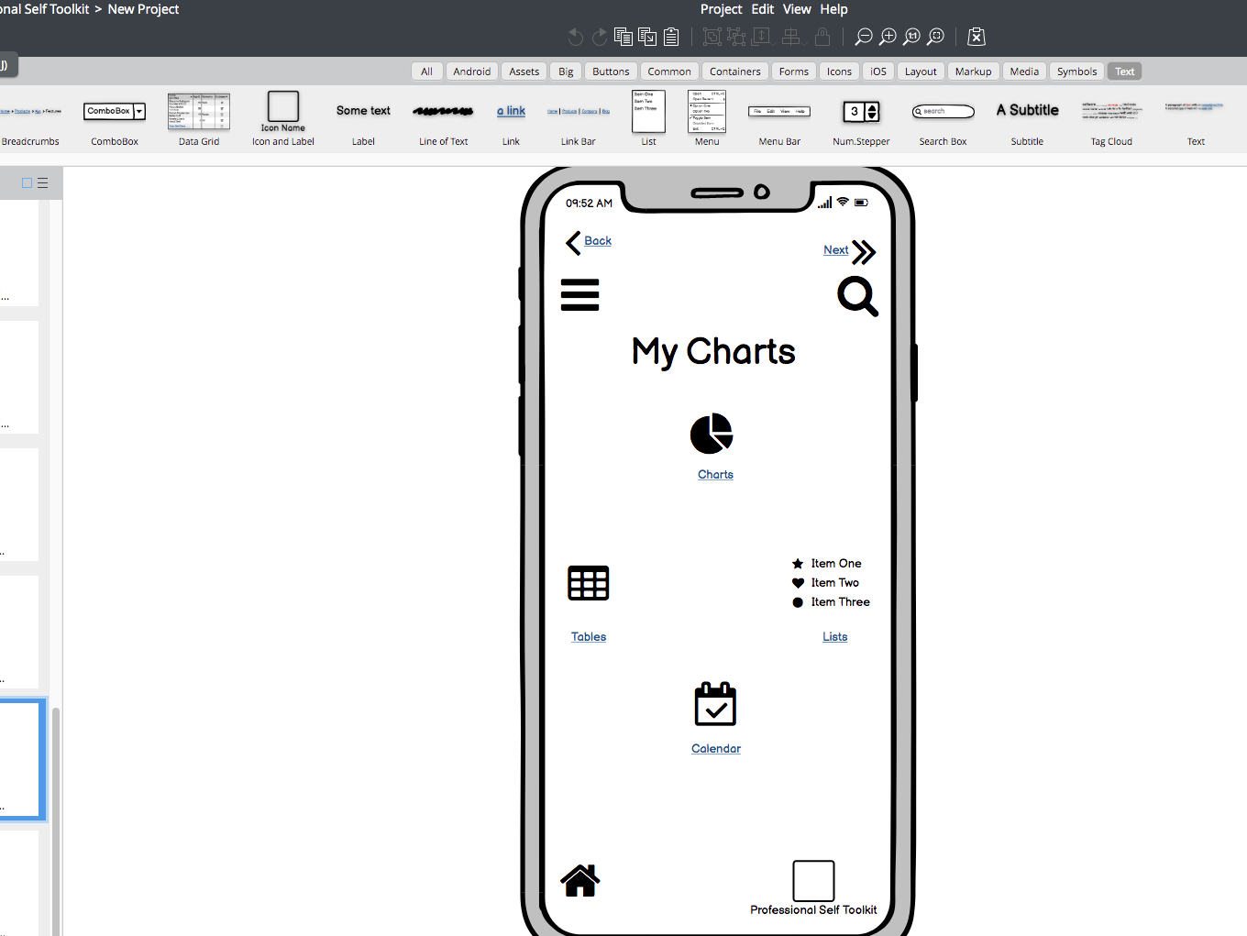
16

Slide 20
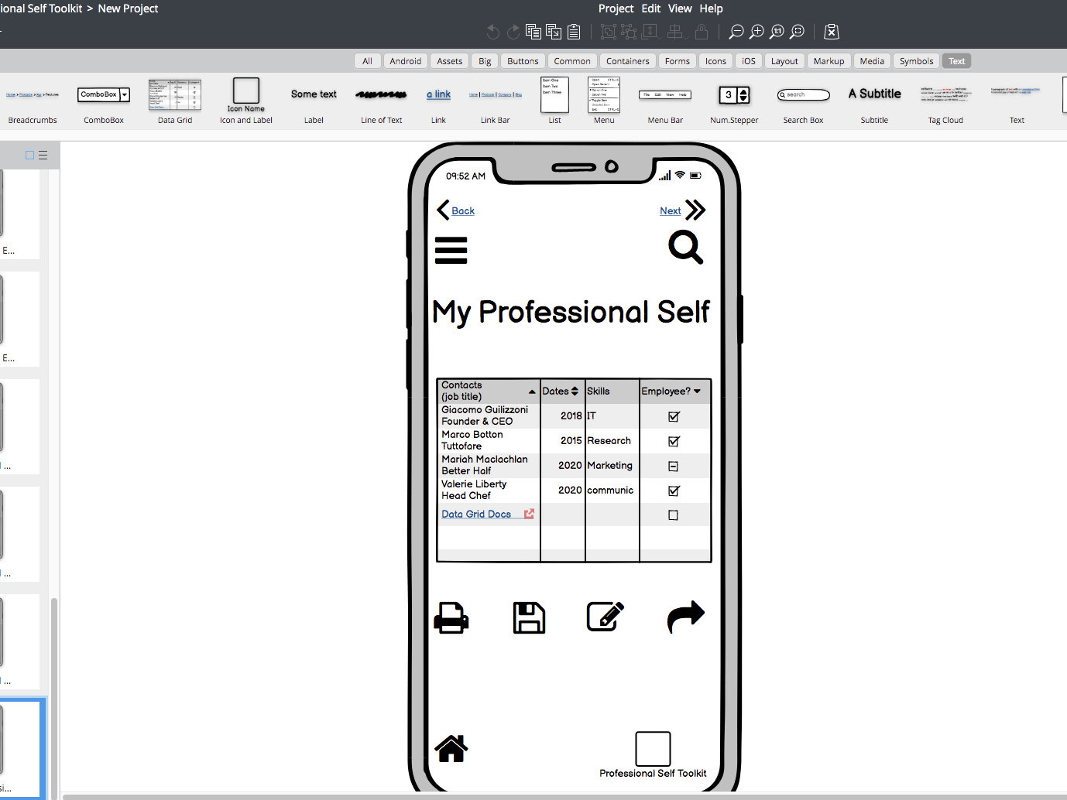
AMALGAMATION OF DATA –
The purpose of this page is
To draw together in display
Mode data entered in
navigation areas 1, 2 & 3
In a final printabale/
downloadable format for
the student
17

Slide 21

WE ARE FLEXIBLE!!
We are happy to discuss adapting and/or changing the following:
Design
Features
Icons
Please however bear in mind that disabled students may need to use the App so where possible be mindful of:
Use of Notifications
Choice of Colours for those who are photosensitive
Display words in place of sounds etc

